Slide 1
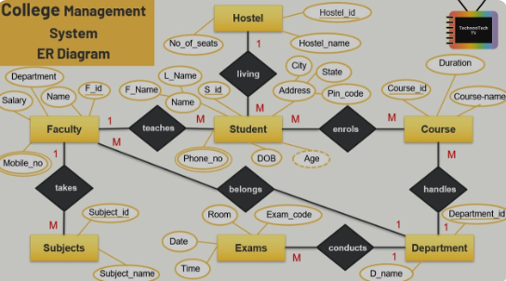

University Management System
Welcome to the University Management System, a comprehensive platform designed to streamline administrative tasks and enhance the learning experience for students, faculty, and administrators.
23DCS064-Meet Nakrani
23DCS049-Dev Khunt
23DCS057-Prince Malaviya

Slide 2

Student Management
1
Adding Students
2
Finding Students
Administrators can add new students to the system by providing their student ID and name.
Administrators can locate specific students by entering their student ID.
3
Student Enrollment
4
Student Grades
Students can enroll in courses, which adds them to the course's enrolled student list.
Faculty can assign grades to students for specific subjects within a course.

Slide 3

Faculty Management
1
Adding Faculty
Administrators can add new faculty members to the system by providing their faculty ID and name.
2
Assigning Courses
Administrators can assign courses to faculty members, establishing their teaching responsibilities.
3
Managing Courses
Faculty can add subjects to courses, enroll students, and schedule lectures.
4
Grading Students
Faculty can assign grades to students for specific subjects within a course.

Slide 4
Course Management
Creating Courses
Adding Subjects
Scheduling Lectures
Administrators can create new courses by specifying the course ID, name, and assigning a faculty member.
Faculty can add subjects to courses, expanding the course's curriculum.
Faculty can schedule lectures for specific subjects within a course, specifying the day, time slot, and subject.

Slide 5

User Interface
Login
Users can log in to the system by providing their username and role (Administrator, Faculty, or Student).
Menu Options
Each user role has a dedicated menu with options relevant to their responsibilities.
Data Input
Users can input data, such as student information, course details, and grades, through user-friendly forms.
Data Display
The system displays information in a clear and organized manner, providing users with easy access to relevant data.

Slide 6




System Features
Data Storage
The system stores all data securely and efficiently, ensuring data integrity and accessibility.
Data Retrieval
Users can easily retrieve data, such as student records, course information, and grades, through search functions and filters.
Data Management
Administrators can manage data, including adding, updating, and deleting records, to maintain accuracy and consistency.

Slide 7
THANK YOU!!

